Slide 1
Welcome to the
Prima Deshecha Landfill
Copyright © 2016 OC Waste & Recycling. All rights reserved.

Slide 2
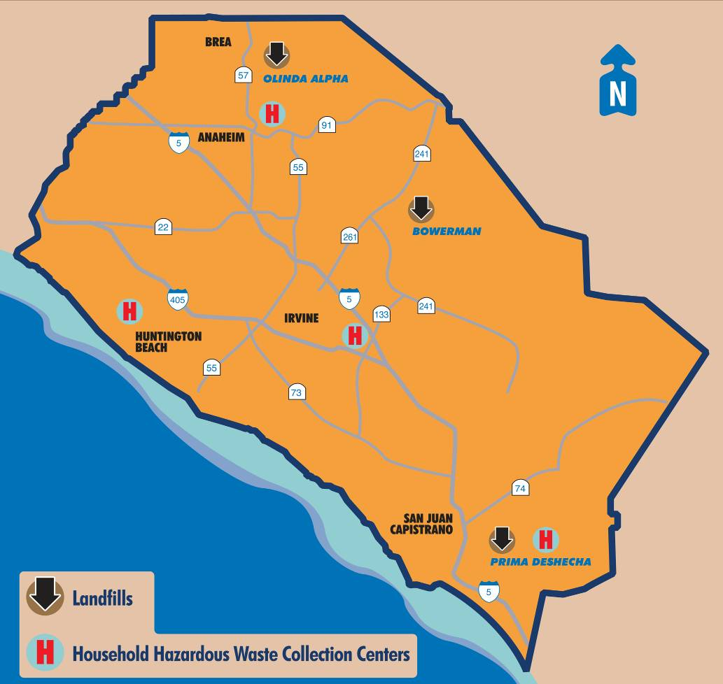
OC Waste Management System
Copyright © 2016 OC Waste & Recycling. All rights reserved.

Slide 3
Prima Deshecha Landfill
Copyright © 2016 OC Waste & Recycling. All rights reserved.

Slide 4
Facts and Figures
Copyright © 2016 OC Waste & Recycling. All rights reserved.

Slide 5
Site Map
Site Office
Zone 1 - Active Waste Disposal Area
Zone 4 – Expansion
La Pata Road Extension
Habitat Restoration
1
3
4
2
5
Copyright © 2016 OC Waste & Recycling. All rights reserved.

Slide 6
Site Map
Copyright © 2016 OC Waste & Recycling. All rights reserved.

Slide 7
Site Office (Green Building)
Copyright © 2016 OC Waste & Recycling. All rights reserved.

Slide 8
Award Winning Landfill
2010 CSAC - HHWCC, Challenge Merit Award
2011 SWANA - Landfill Management Excellence Award (Bronze)
2015 NACo - Landfill Good Neighbor Policy, Achievement Award
2015 ACCOC - Landfill Good Neighbor Policy, Golden Hub of Innovation
Copyright © 2016 OC Waste & Recycling. All rights reserved.

Slide 9
Fee Booth and Scales
Copyright © 2016 OC Waste & Recycling. All rights reserved.

Slide 10
Active Waste Disposal Area
Copyright © 2016 OC Waste & Recycling. All rights reserved.

Slide 11
Household Hazardous Waste Collection Center
Fiscal Year 2013/2014 Program Participation
San Juan Capistrano 12,289
Huntington Beach 35,653
Irvine 36,343
Anaheim 34,636
TOTAL 118,921
Copyright © 2016 OC Waste & Recycling. All rights reserved.

Slide 12
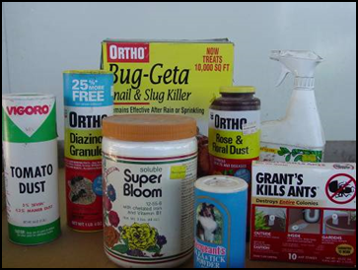
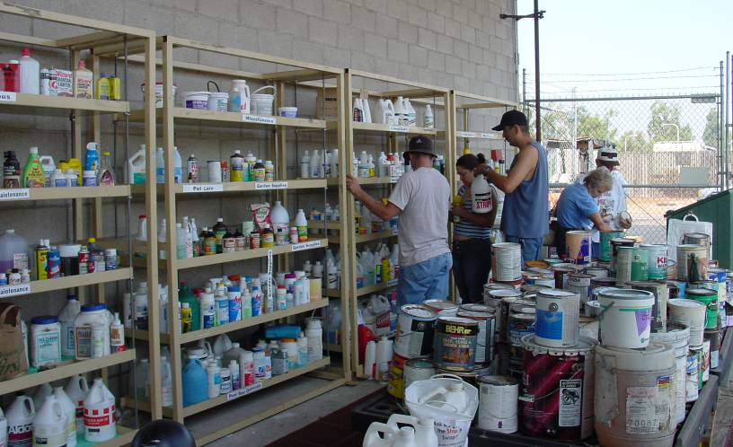
Material Exchange Program
Copyright © 2016 OC Waste & Recycling. All rights reserved.

Slide 13
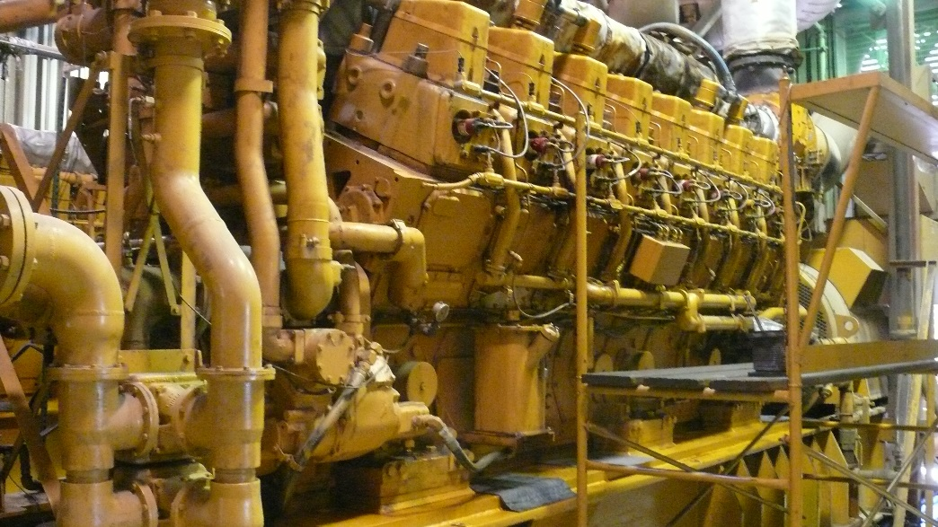
Gas to Energy Plant
Public-Private Partnership
5.5 MW Power Plant
Two 4,000 HP IC Engines
Provides power for about 5,500 homes
Copyright © 2016 OC Waste & Recycling. All rights reserved.

Slide 14
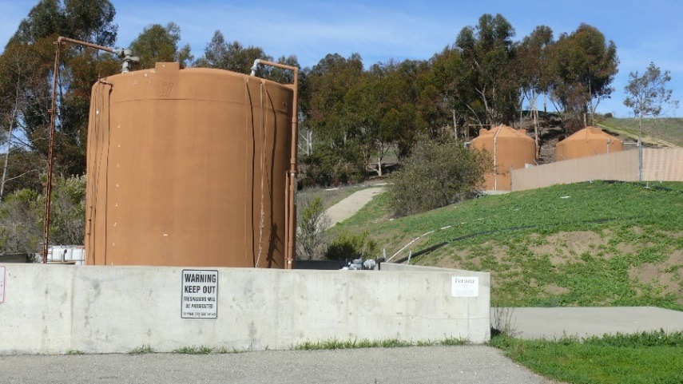
Environmental Protection
Groundwater monitoring wells
Groundwater collection system
Leachate collection and recovery system (Liner)
Landfill gas collection system
Hazardous waste observation/removal program
Radioactive waste observation program
Drainage improvements
Erosion and sediment control systems
Litter Control
Bird Control Program
Odor Control Best Management Practices
Copyright © 2016 OC Waste & Recycling. All rights reserved.

Slide 15
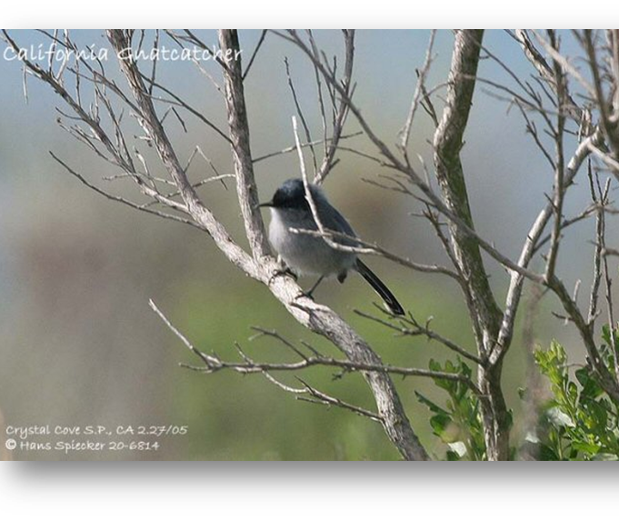
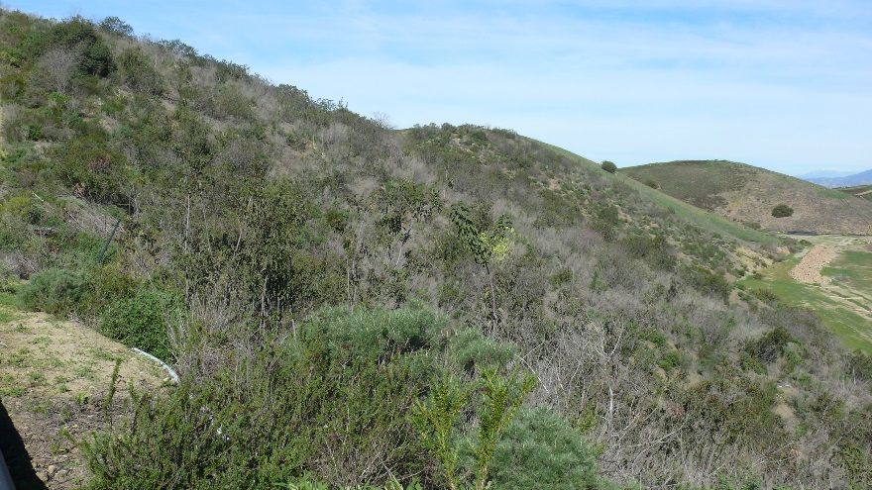
Biological Pre-Mitigation
California gnatcatcher
Copyright © 2016 OC Waste & Recycling. All rights reserved.

Slide 16
Regional Trails
Copyright © 2016 OC Waste & Recycling. All rights reserved.

Slide 17
Zone 4 – Future Expansion
Copyright © 2016 OC Waste & Recycling. All rights reserved.

Slide 18
Future of Prima Landfill
Continue operational and regulatory excellence
Extend site life
Research new technologies
Continue positive relationship with host cities and communities
Implement sustainable landfilling and business practices
Copyright © 2016 OC Waste & Recycling. All rights reserved.

Slide 19
Questions?
Kevin H. Kondru, P.E.
Regional Landfill Manager,
OC Waste & Recycling - South Region
E-mail: Kevin.Kondru@ocwr.ocgov.com
Phone: (949) 728-3043
Copyright © 2016 OC Waste & Recycling. All rights reserved.

